Slide 1
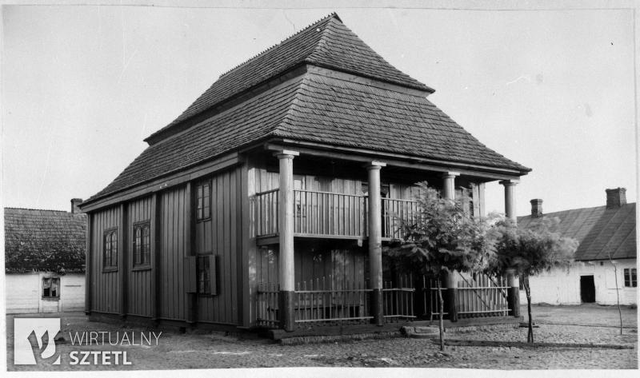
The Synagogue in Mogielnica
Source: Collection of the Institute of Art of the Polish Academy of Sciences, Warsaw, file number 159669
Title: Synagogue in Mogielnica, general view.
Author: Szymon Zajczyk
Date of execution: August 23, 2017 I
D: 84571

Slide 2
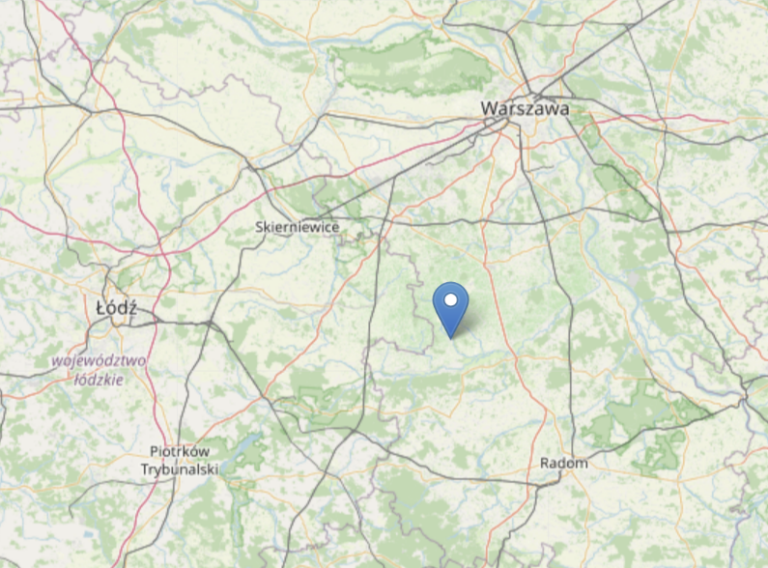
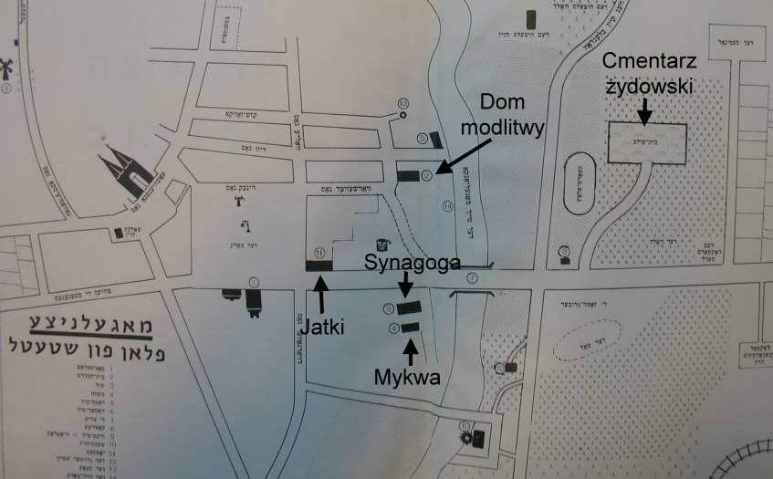
Localisation
Source: https://www.openstreetmap.org/search?query=Mogielnica#map=8/51.690/20.723
Source: http://cmentarze-zydowskie.pl/mogielnica021.htm
Title: Plan of Mogielnica with marked buildings of the Jewish community (source: "Book of Mogielnica and Błędowa Remembrance")

Slide 3
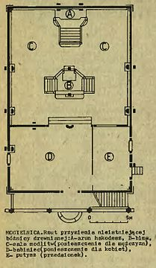
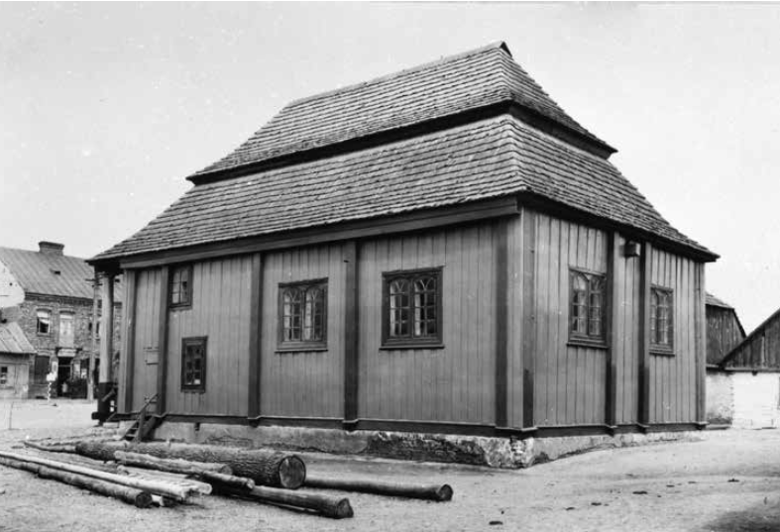
History
The synagogue in Mogielnica was established in 1856. It was located at Dół Street. It was destroyed by the Germans during World War II. Not rebuilt after the war.
The wooden building was covered with a „broken” Polish roof, supported on four columns from the front. The synagogue had a square prayer hall with four windows and two women's rooms. The interior walls are decorated with polychrome.
Source: „Gates of Heaven”
Source: https://pl.wikipedia.org/wiki/Synagoga_w_Mogielnicy#/media/Plik:Synagoga_w_Mogielnicy_01.jpg
Title: Plan of the synagogue in Mogielnica

Slide 4
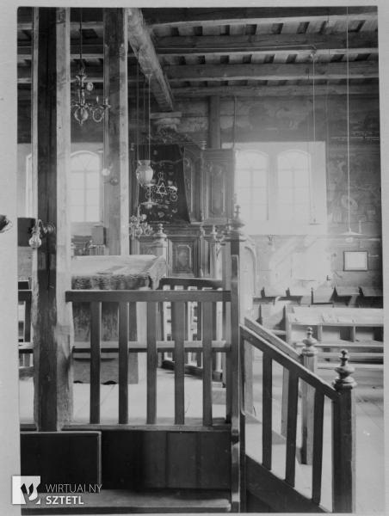
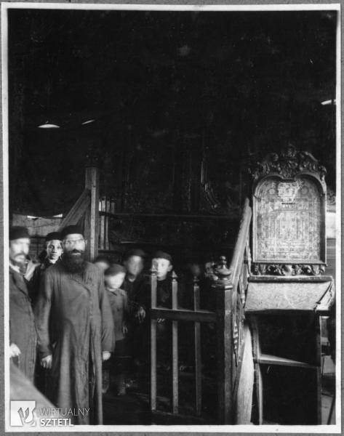
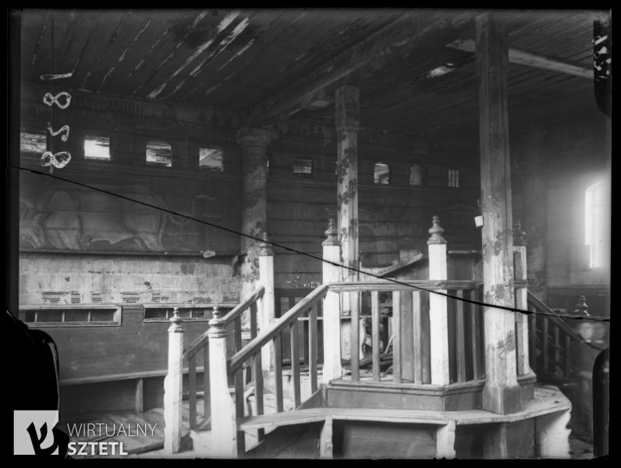
Interior photos
Source: Collection of the Institute of Art of the Polish Academy of Sciences, Warsaw, file number 0093
Title: The interior of the synagogue in Mogielnica - aron ha-kodesh.
Author: Unknown
Date of execution: August 23, 2017
ID: 55290
Source: Collection of the Institute of Art of the Polish Academy of Sciences, Warsaw, file number 0093
Title: The interior of the synagogue in Mogielnica - aron ha-kodesh.
Author: Unknown
Date of execution: August 23, 2017
ID: 55290
Source: Collection of the Institute of Art of the Polish Academy of Sciences, Warsaw, file number 8281
Title: Interior of the synagogue in Mogielnica - bimah.
Author: Unknown
Date of execution: August 23, 2017
D: 28954

Slide 5
Documentation from PAN
Description from „The Gates of Heaven”
„The main hall is almost square (9.00 × 8.60 m, height about 4.80 m). In the ground floor, from the south, there is a hall and a room accessible from it, originally the same one as large as the hallway, before 1914 it was turned into a women's gallery.
Above them, upstairs, second room for women. The building was preceded by a three-bay portico with columns about "dorying" heads. The outer door to the vestibule was in his the extreme, left bay - they were suited to the location of the entrance from the hall to the main hall, moved from the axis of the room towards the side wall. Into the right extreme bay of the portico an external, single-flight staircase was built in, leading to the landing in the central bay in front of the door to the women's gallery.
Log walls with vixens - the inner vixens were given the shape of half-columns with a detail similar to the columns of the portico. In the outer walls of the hall after two twin windows with lintels cut into segmental arches. Grandma's windows and a single, rectangular hall. The women's gallery on the first floor is connected to the hall by a row small windows, women's gallery on the ground floor - a crack cut in the wall. All rooms had flat ceilings. The whole thing was covered on the ceiling, a two-story, hipped broken roof with a stanchion.”
Source: Collection of the Institute of Art of the Polish Academy of Sciences, Warsaw, file number 0093
Title: The interior of the synagogue in Mogielnica - aron ha-kodesh.
Author: Unknown
Date of execution: August 23, 2017
ID: 55290
Source: Collection of the Institute of Art of the Polish Academy of Sciences, Warsaw, file number 0093
Title: The interior of the synagogue in Mogielnica - aron ha-kodesh.
Author: Unknown
Date of execution: August 23, 2017
ID: 55290
Source: Gates of Heaven, page 387

Slide 6
Documentation from PAN
Description from „The Gates of Heaven”
The ceiling beams were supported in the middle of the span with a longitudinal binder on the transverse walls, vixens and two pillars standing in the middle of the hall.
Aron Kodesh - on the northern axis, the "Gdańsk" wardrobe is placed on a raised platform, above it, a superstructure made of boards with a painted inscription and a crown. Bimah - a podium built between two pillars supporting the joist ceiling.
Polychrome walls. On the entrance wall, on the right, above doors, Heaven's Gate - a painted portal enclosed in barbarized columns, with stems braided with vines, carrying vases with flowers, topped with a crown, antithetical lions on the sides.

Slide 7
Documentation from PAN
Description from „The Gates of Heaven”

Slide 8
Documentation from PAN
Description from „The Gates of Heaven”
„On the left, a great ox Shor ha-Boron. Under the ceiling, above the windows, probably running around the entire room a frieze depicting a landscape with trees, animals and architecture. On wall with Aron Kodesh between the window and the corner - instruments musical. Half-columns of foxes and bimah poles entwined with vines. Ceiling no polychrome.
In the 1920s, during the restoration, the walls were raised, underpinned. plinth and the collapsed roof was rebuilt. At the expense of the ground floor women's gallery, the hall was enlarged, external doors were moved to the axis of the building, to the hall and from the hall to the hall, changing the latter into double doors, at the same time, the lower part of the vixen - the half-columns - was cut out. Originally flat the decking of the ceiling from the bottom of the beams was replaced with a ceiling nailed from above on. overlay.
The aron ha-kodesh was replaced - the Gdańsk wardrobe was replaced with another a piece of furniture – a sideboard from the end of the 19th century. The old ones were also removed finial with crown and inscriptions.”
Source: Gates of Heaven, page 387

Slide 9
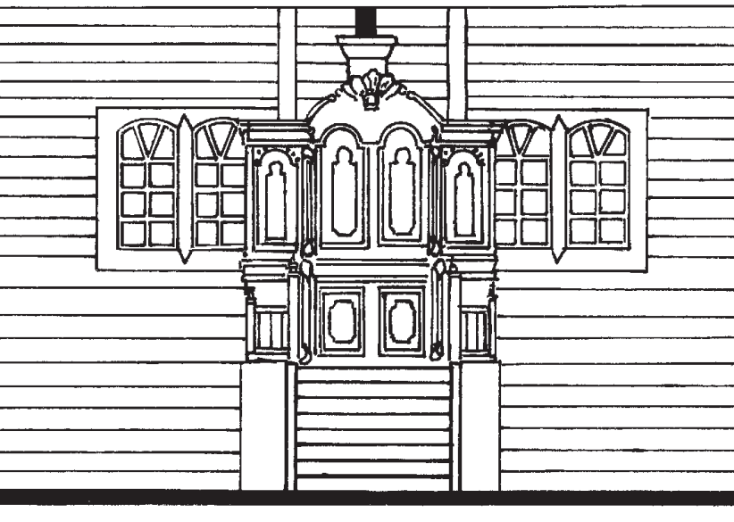
Lacking resources
Back elevation
Side elevation
Detailed Information about the colors of the polychroms (analogical approach needed?)
Interior design

Slide 10
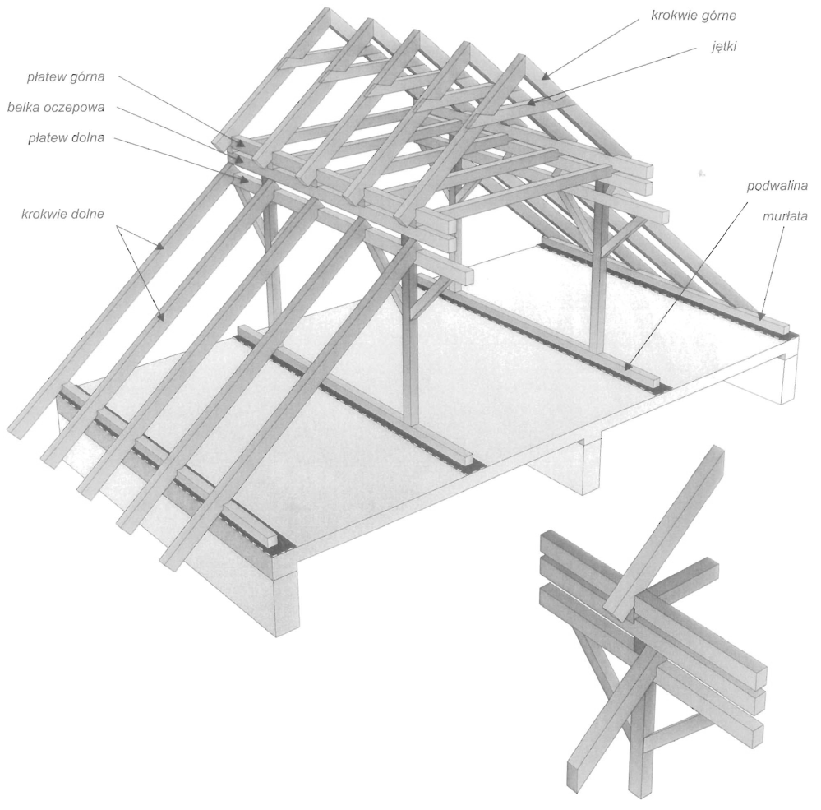
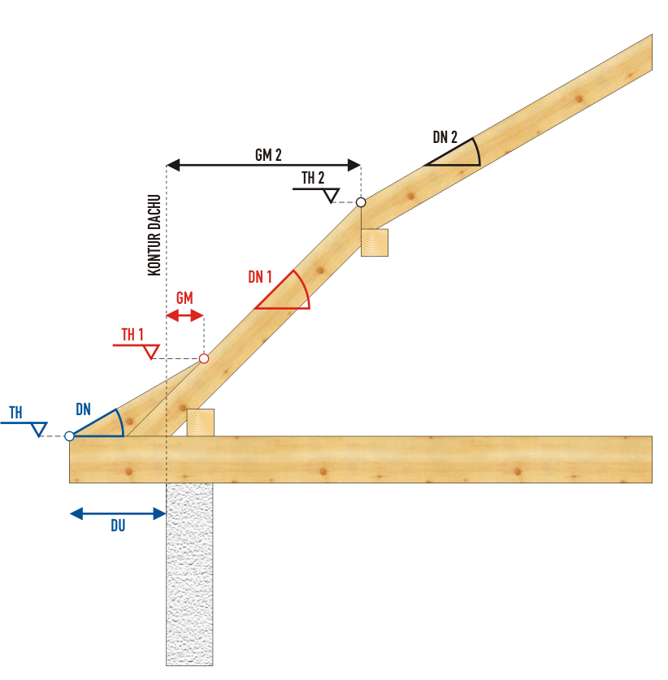
Roof construction
Polish „broken” (pitched) roof

Slide 11
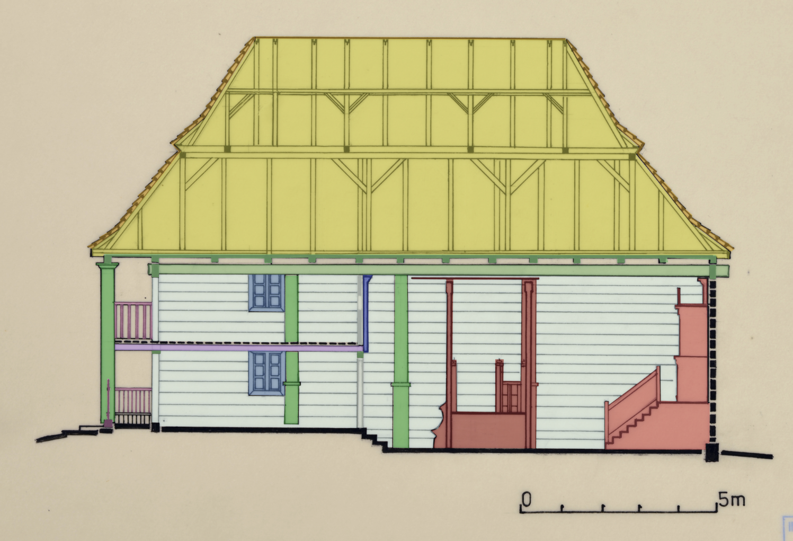
Semantic division
Structural element
Roof truss
Roof sheathing
Beam
Ceiling
Mechitza
Bimah
Aron Ha-Kodesz
Pole
Window
Railing
12. Wall

Slide 12
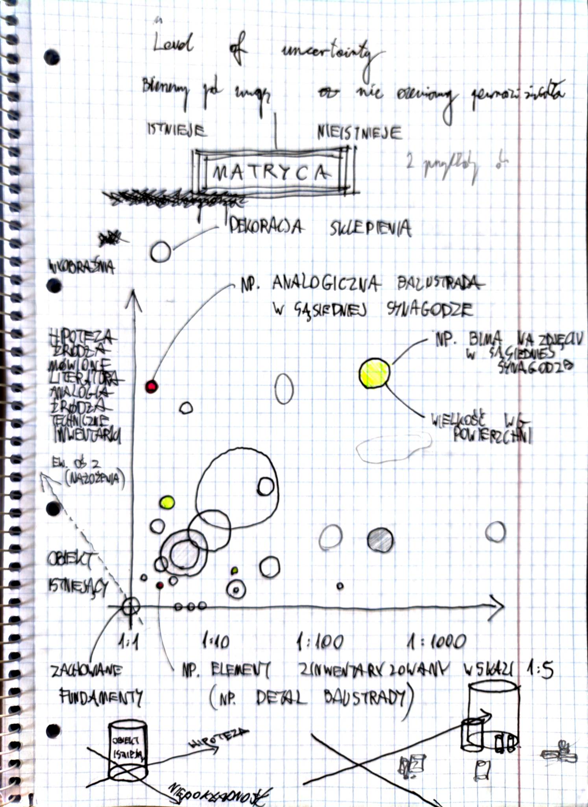
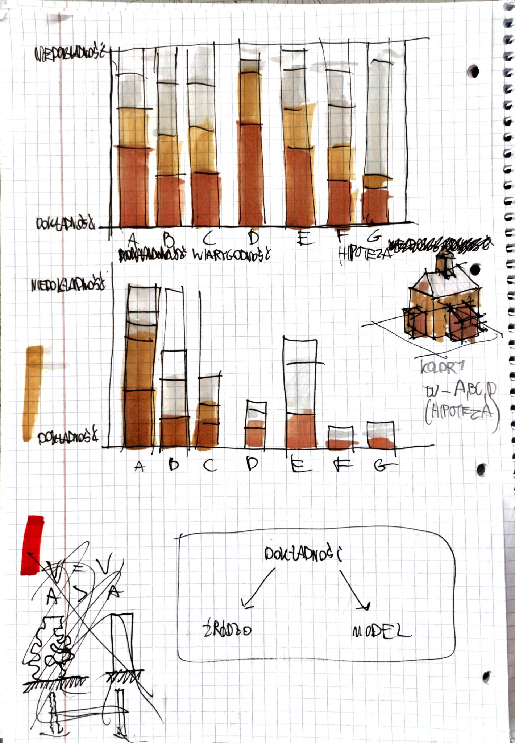
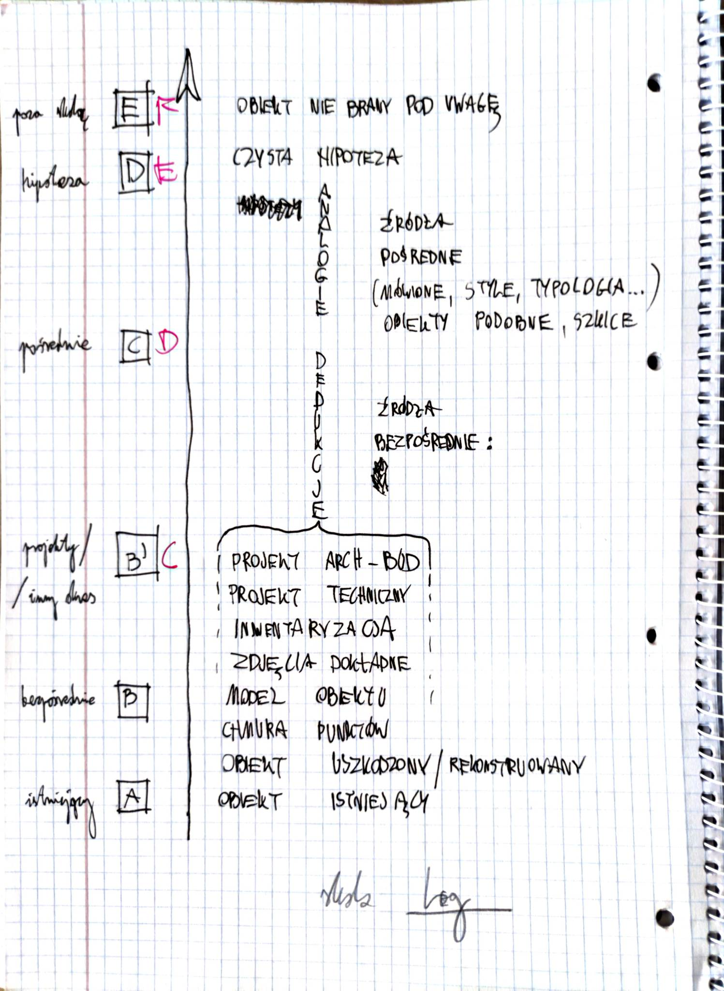
Matrix – work in progress

Slide 13
Sources
Bramy Nieba, M., K. Piechotkowie;
Collection of the Institute of Art of the Polish Academy of Sciences, Warsaw;
http://cmentarze-zydowskie.pl/mogielnica021.htm
http://www.kosciolydrewniane.pl/pages/drewniane/stare/40644.html
https://bc.radom.pl/dlibra/publication/2396/edition/2314#info
https://fet.uwe.ac.uk/conweb/house_ages/elements/section5.htm
https://sztetl.org.pl/pl/miejscowosci/m/1241-mogielnica/112-synagogi-domy-modlitwy-mykwy/87150-synagoga-w-mogielnicy
https://web.archive.org/web/20120705002205/http://www.jewishinstitute.org.pl/pl/gminy/miasto/374.html
https://www.jewishgen.org/yizkor/Mogielnica/Mogielnica.html
http://www.bfcollection.net/cities/poland/mogielnica/mogielnica.html
https://cja.huji.ac.il/browser.php?mode=set&id=22159
https://bloodandfrogs.com/wp-content/uploads/encyclopedia/poland/kirkuty/mogielnica.htm
Julia Wiśniewska & Adam Miziołek, Lodz University of Technology, 2023

