Slide 1
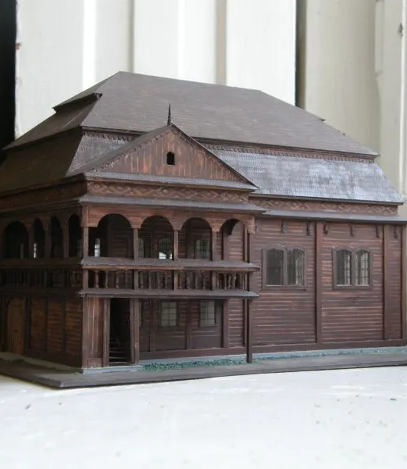
Synagogue in Końskie Jędruszek Agnieszka, Łukasz Polewczyk

Slide 2
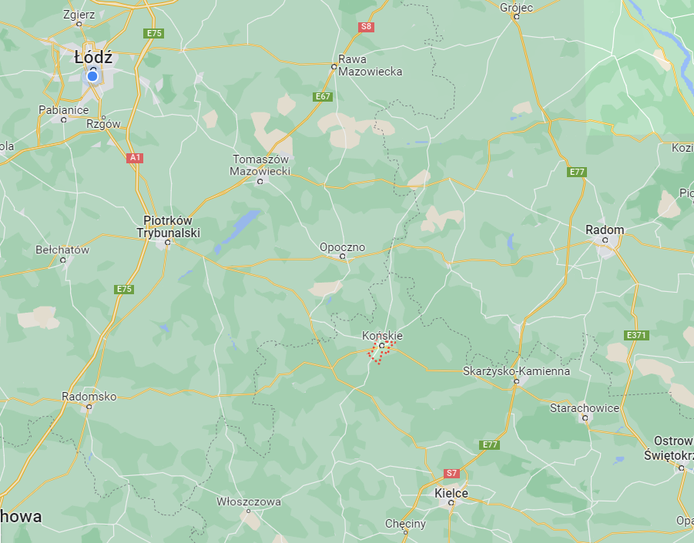
Localisation
Końskie is a town in south-central Poland, situated in the Świętokrzyskie Voivodeship.

Slide 3
History
1748 Location privilege
1780 The construction of the synagogue was completed.
1905 Refurbishment of the synagogue
The gallery on the western wall was initially covered with wooden planks and then, during the refurbishment of the synagogue, it was liquidated as a brick wall was built while preserving the existing roof. Alongside the southern wall, a floor-level brick area for women was built at that very time.
1939 (11 September)
A group of German soldiers poured petrol over it and set fire to the synagogue.

Slide 4
Short description
Woman section located above vestibule
Walls fastened with corners
Two storey truss
Octagonal dome on corners and a facet, octagonal dome on corners and a facet composed of two bowls placed on top of each other and separated by balustrads
Broken hip roof mounted on profiled brackets
Storeys separated by friezes and cornices

Slide 5
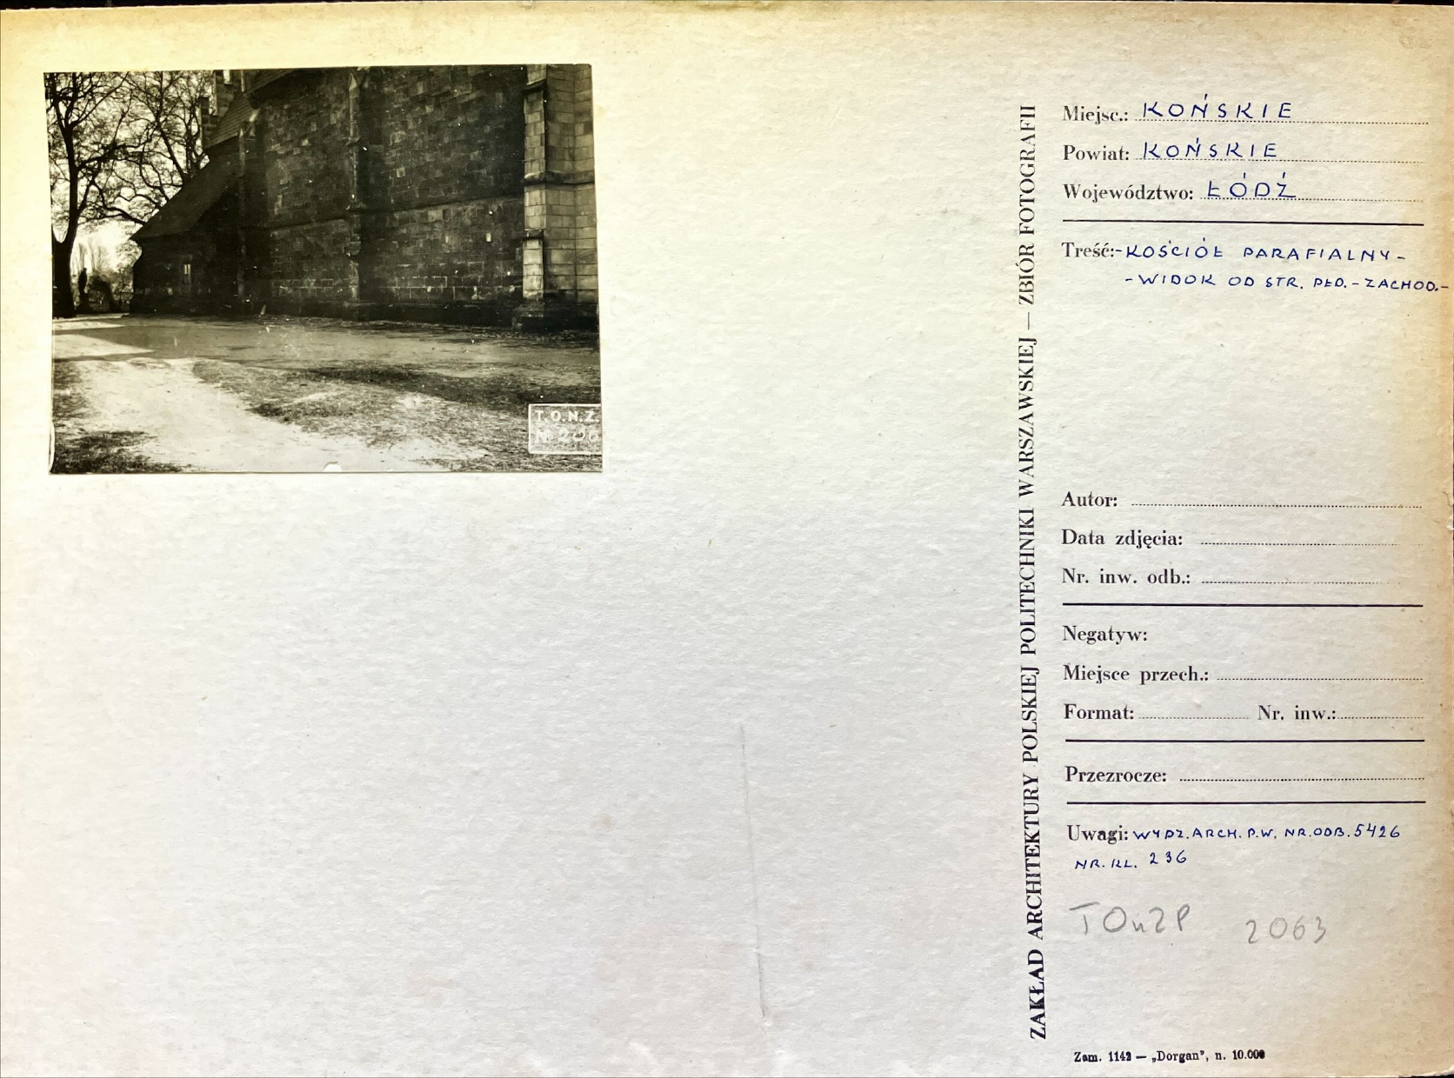
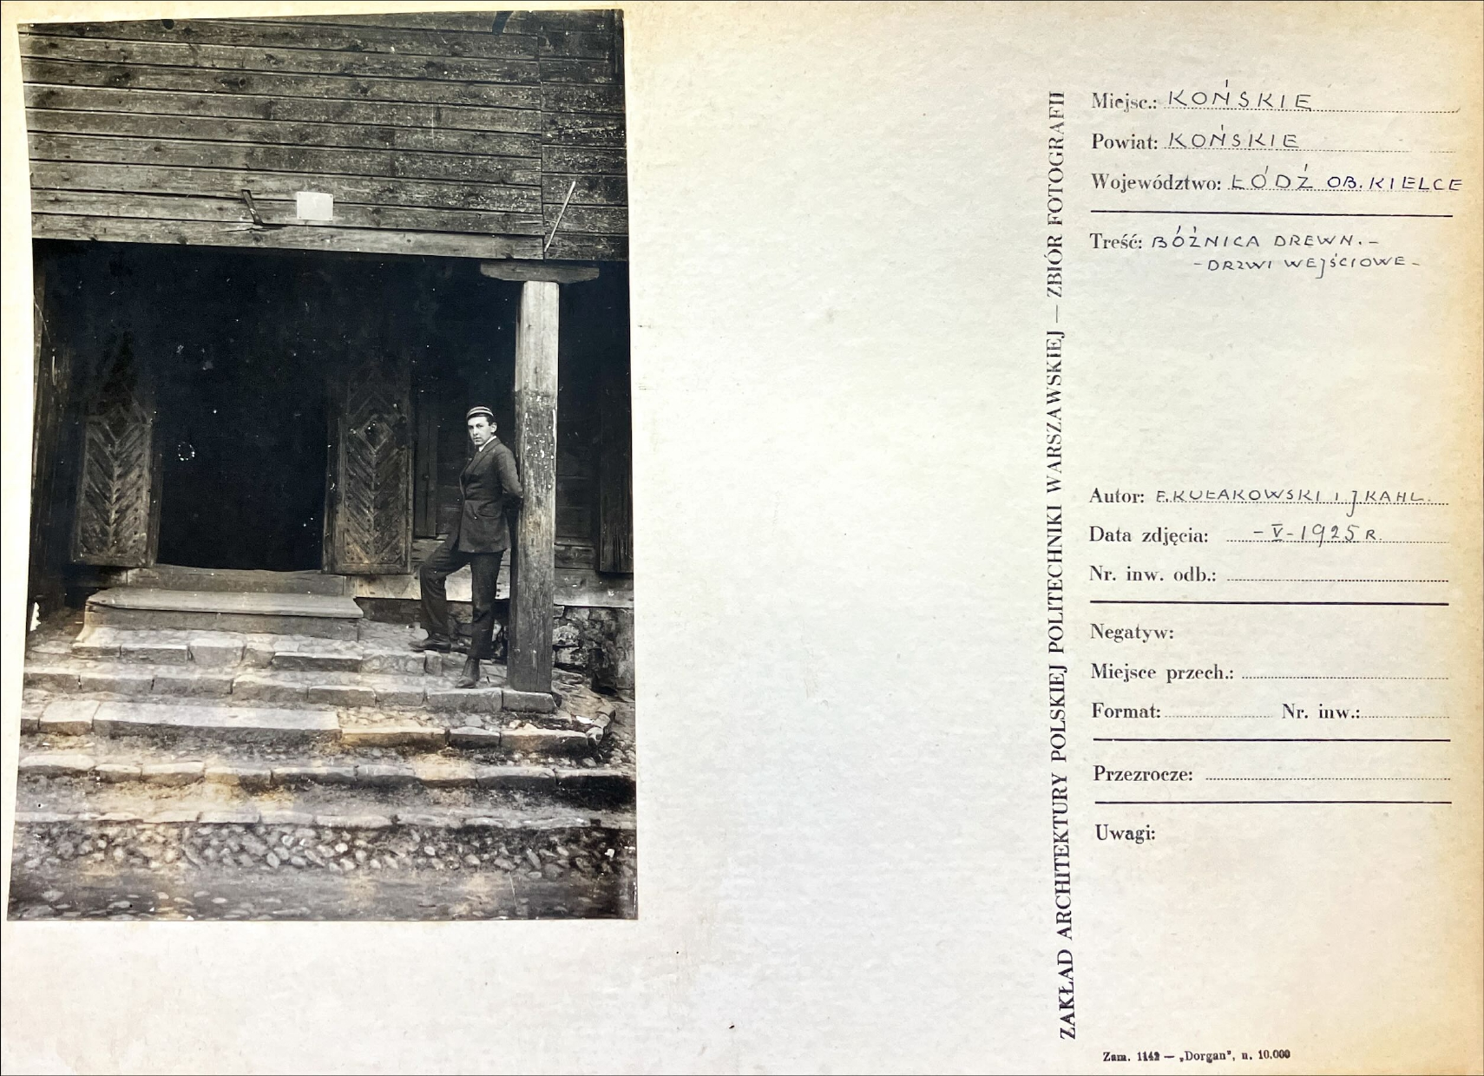
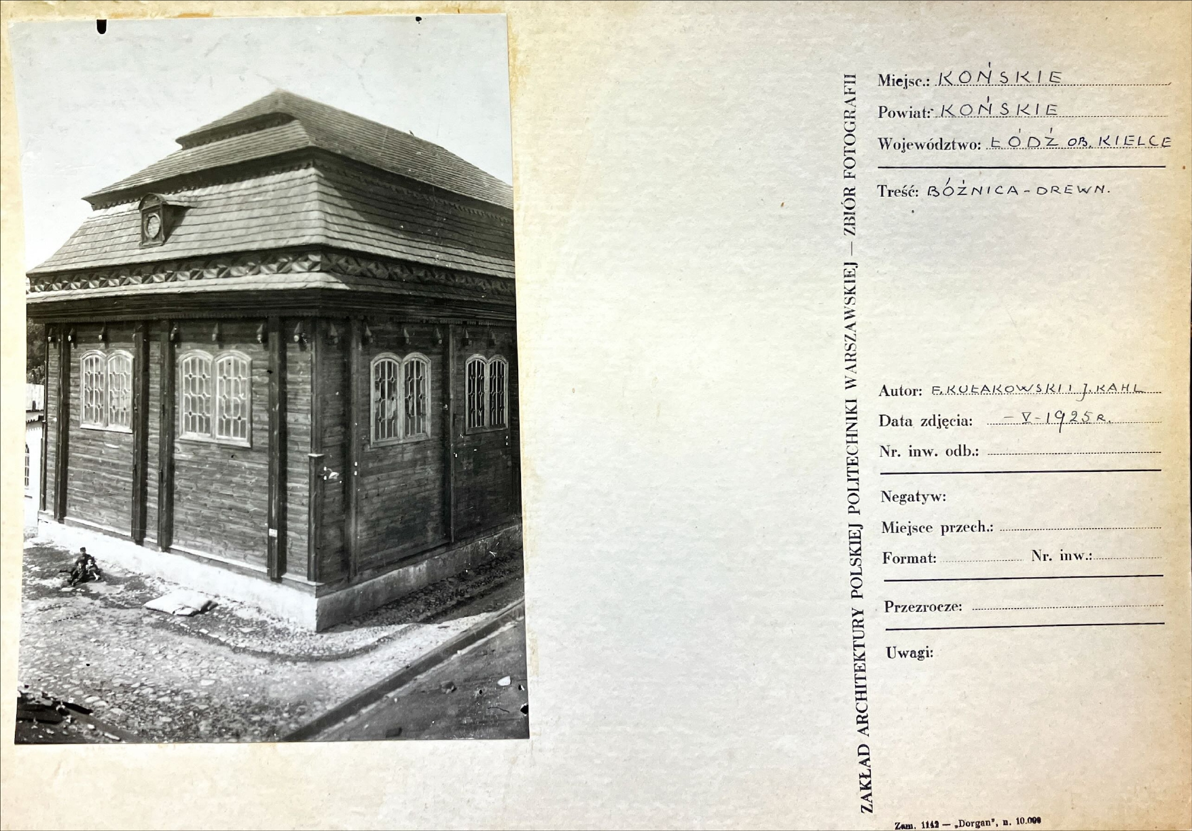
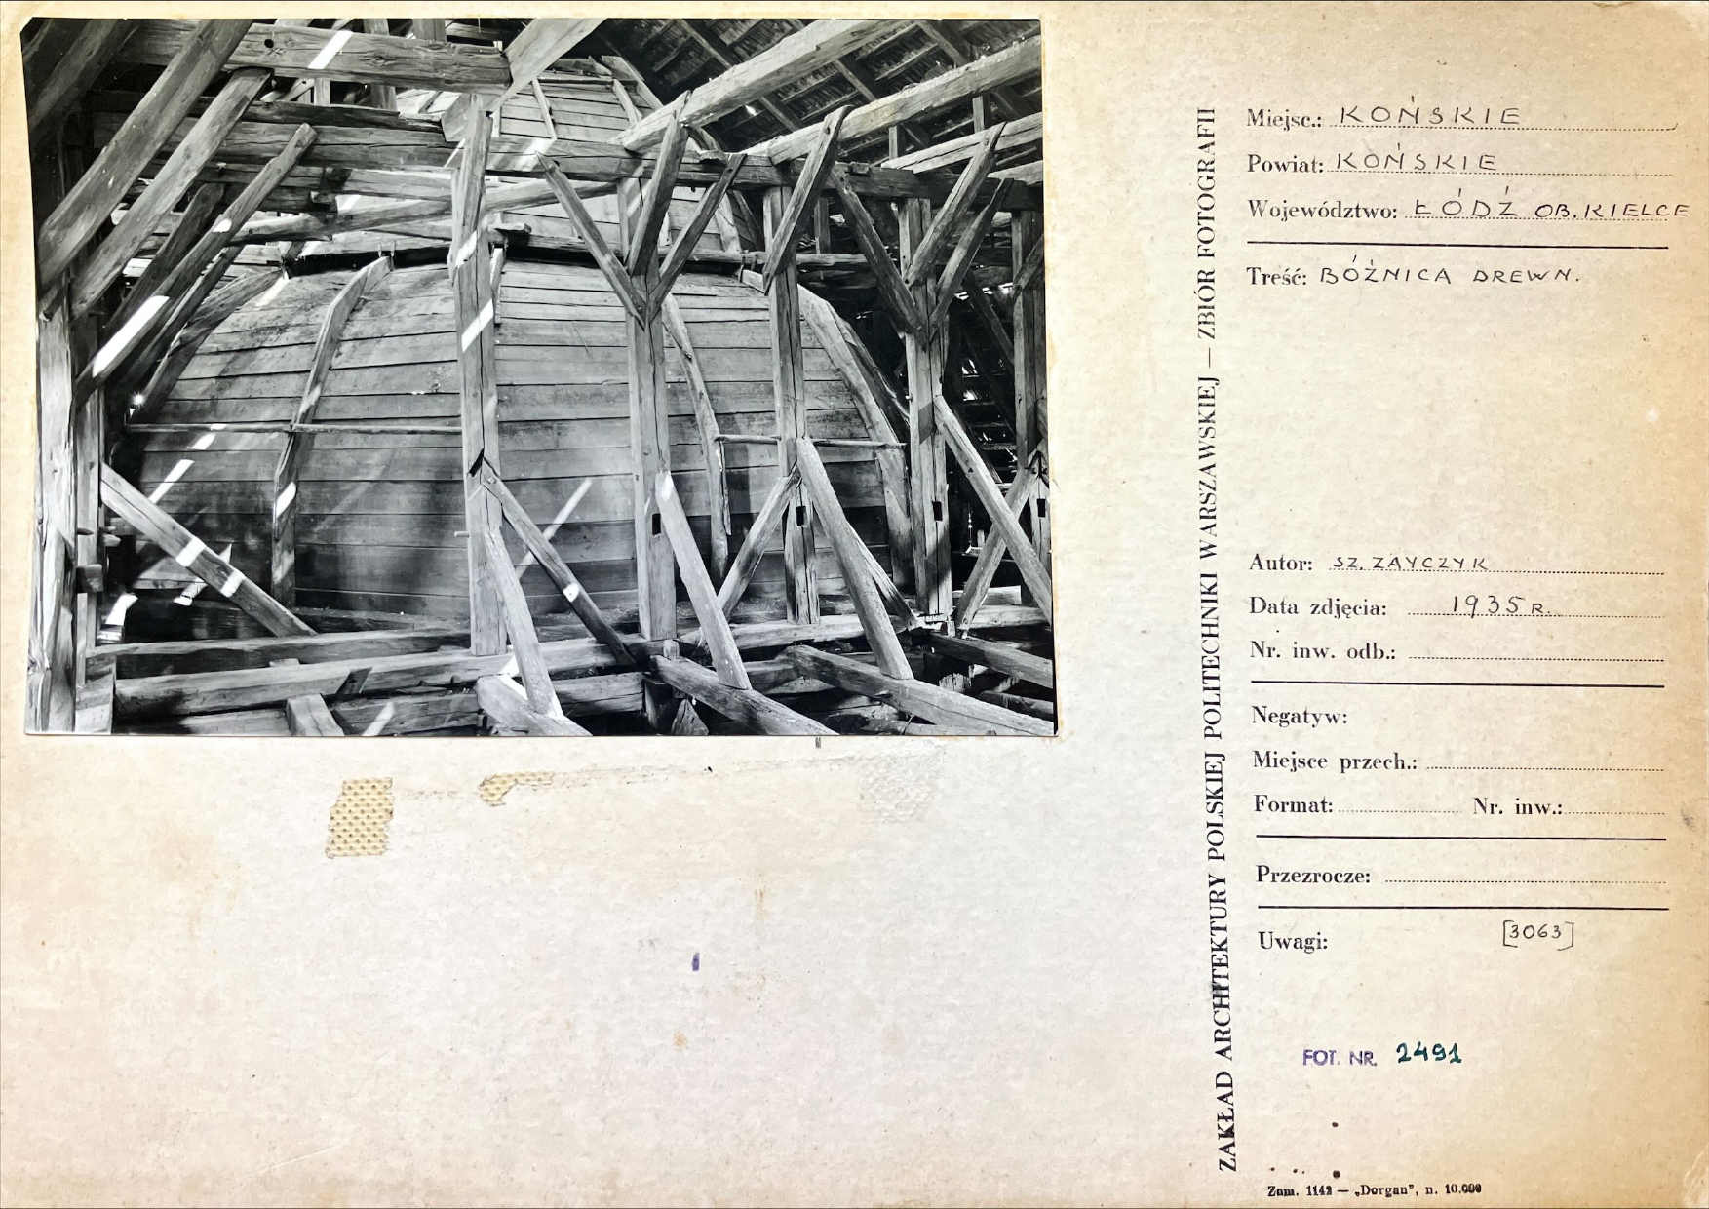
ZAP SOURCES

Slide 6
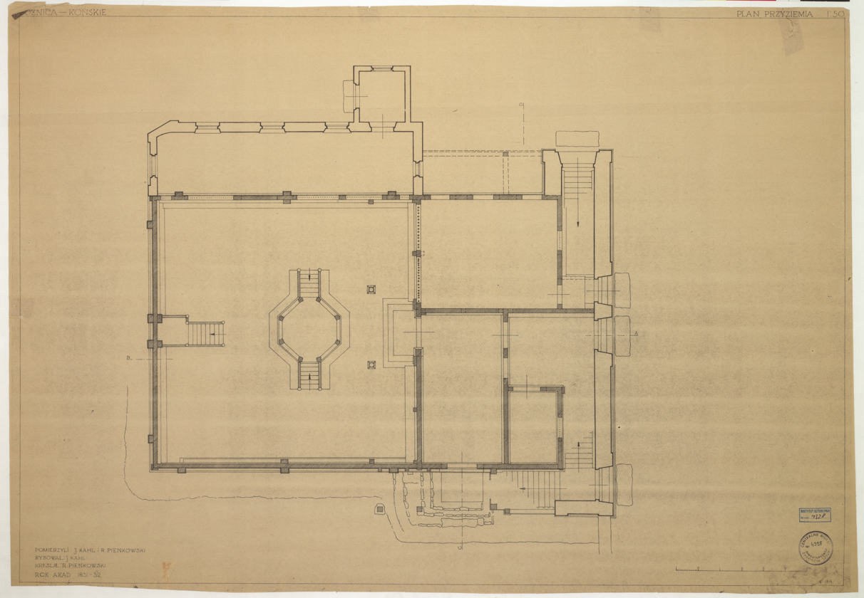
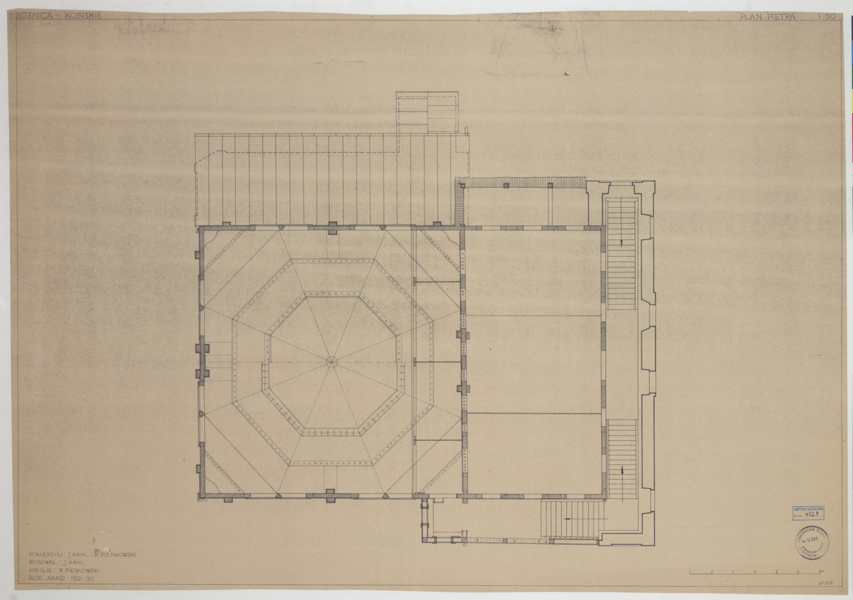
Floor plans
1931-32 J. Kahl, R. Pieńkowski, ZAP
1931-32 J. Kahl, R. Pieńkowski, ZAP

Slide 7
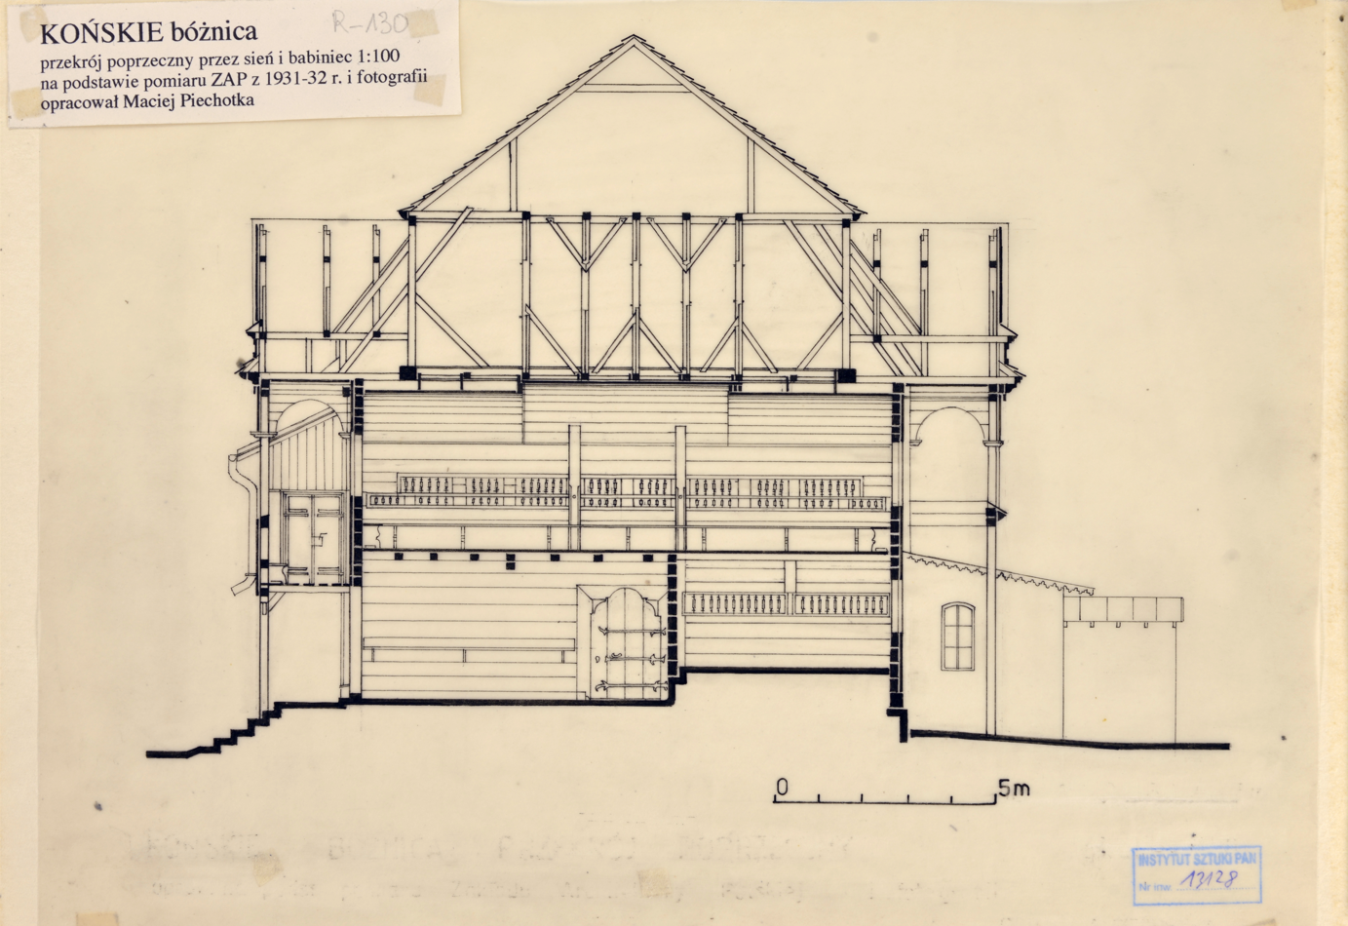
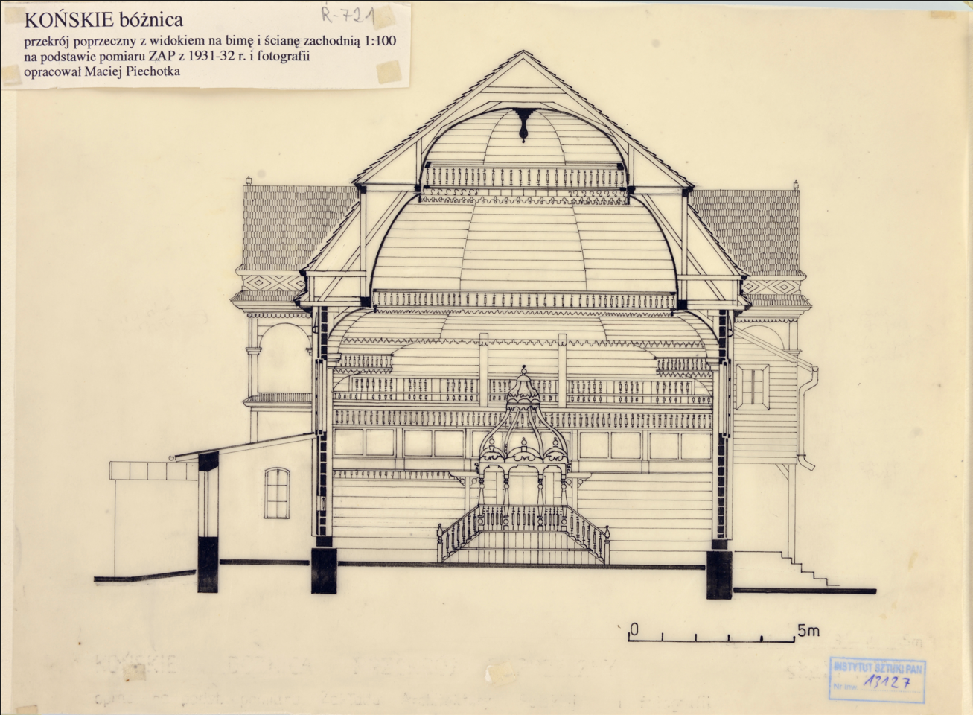
Sections
A-B
C-D
?
1931-32 M. Piechotka, ZAP
1931-32 M. Piechotka, ZAP
1931-32 M. Piechotka, ZAP

Slide 8
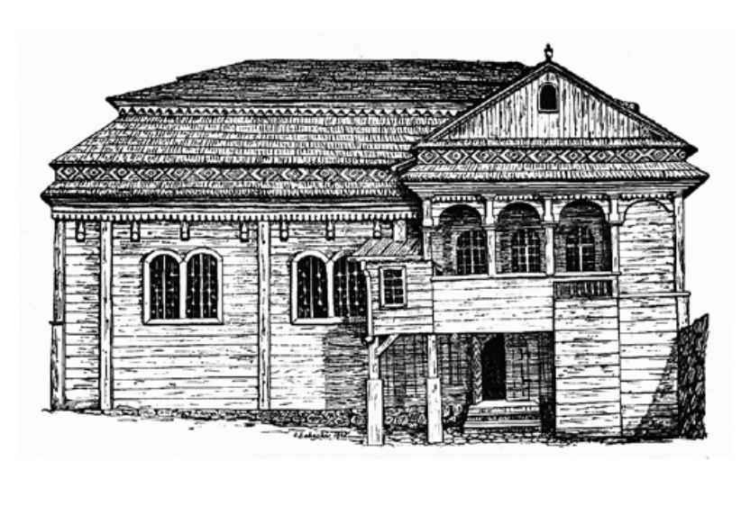
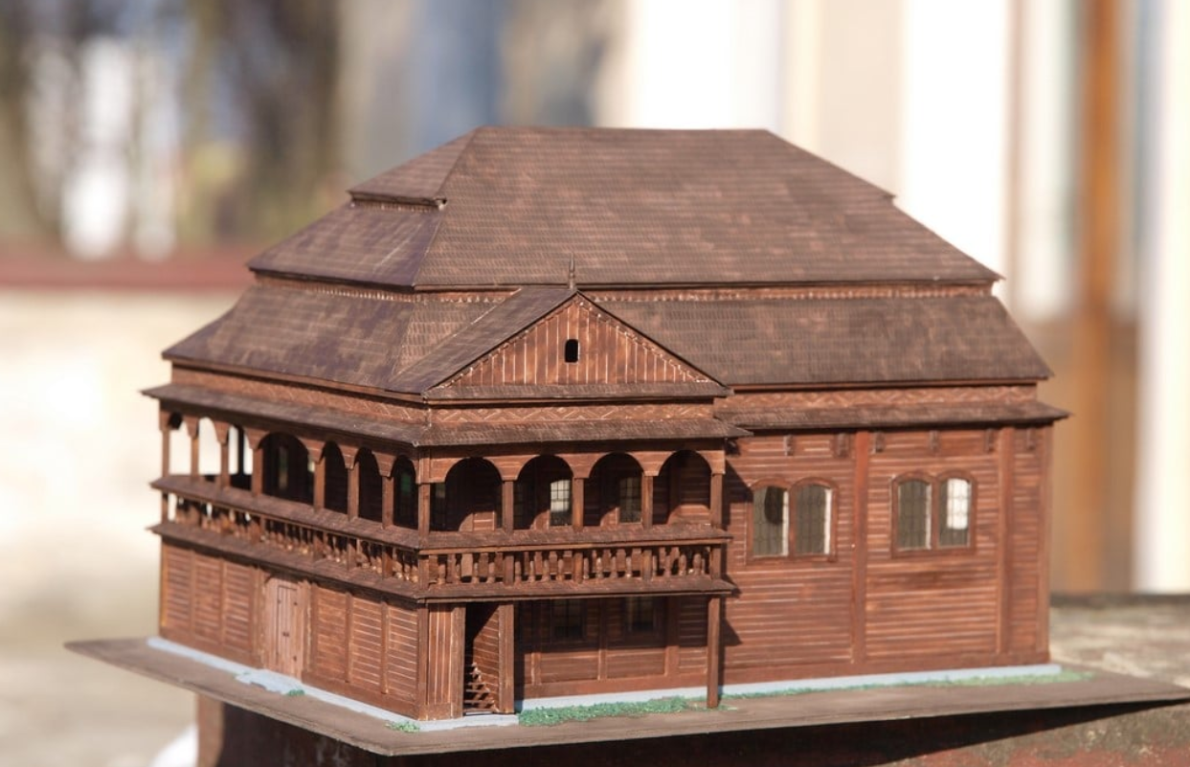
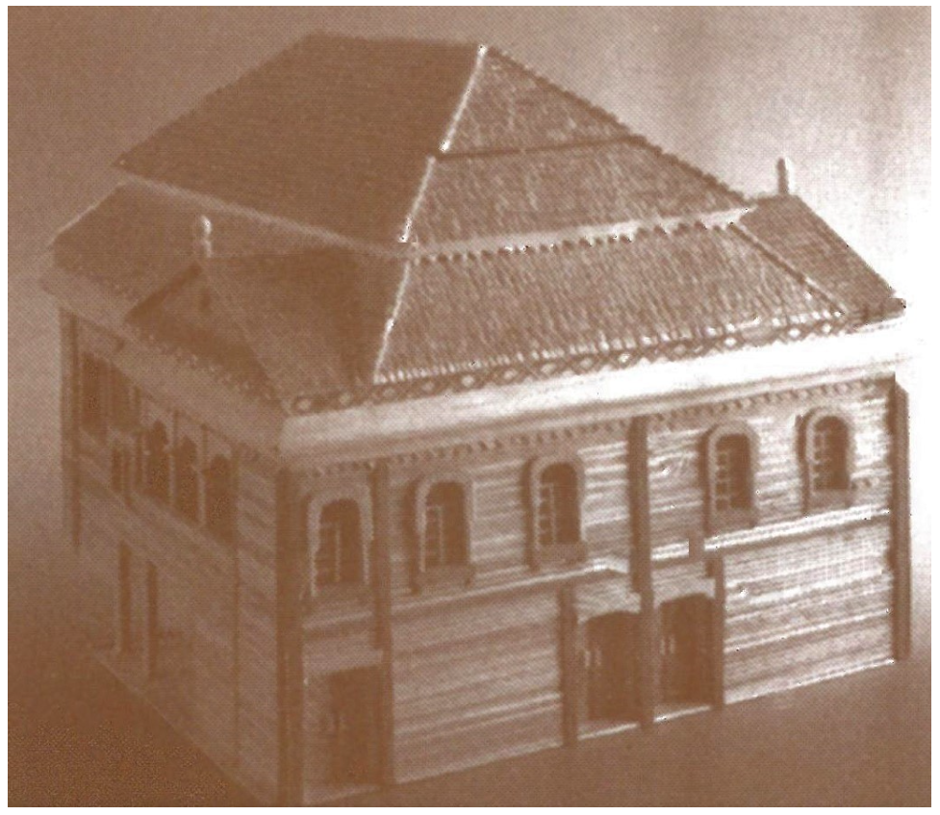
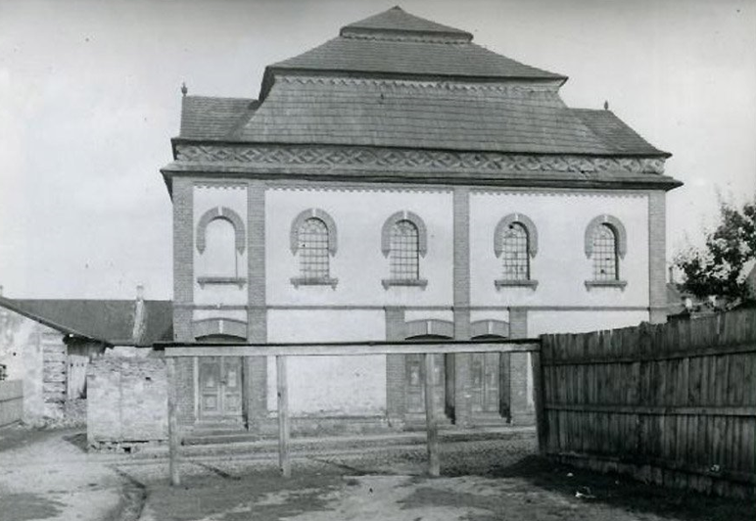
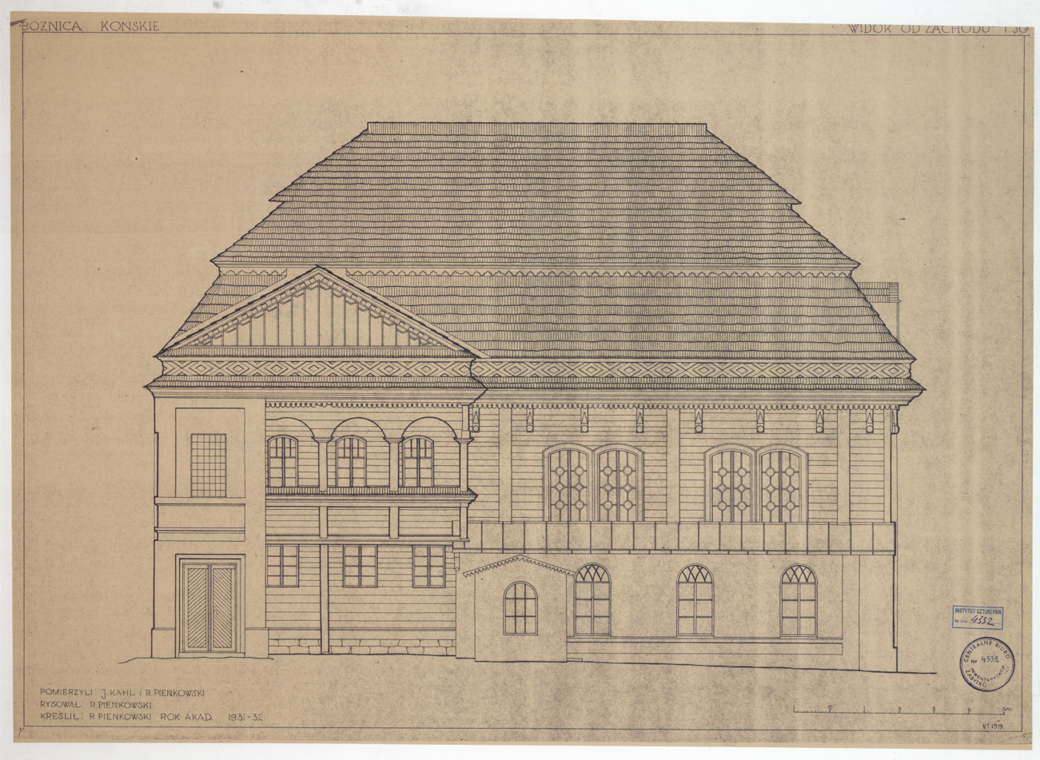
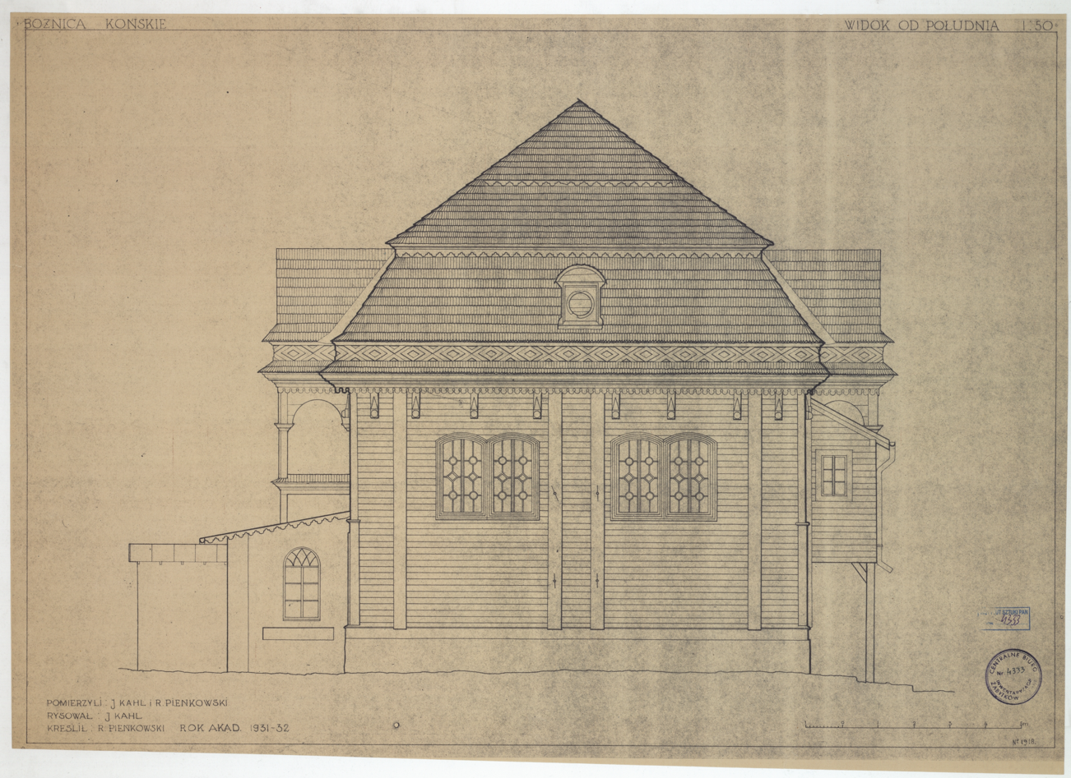
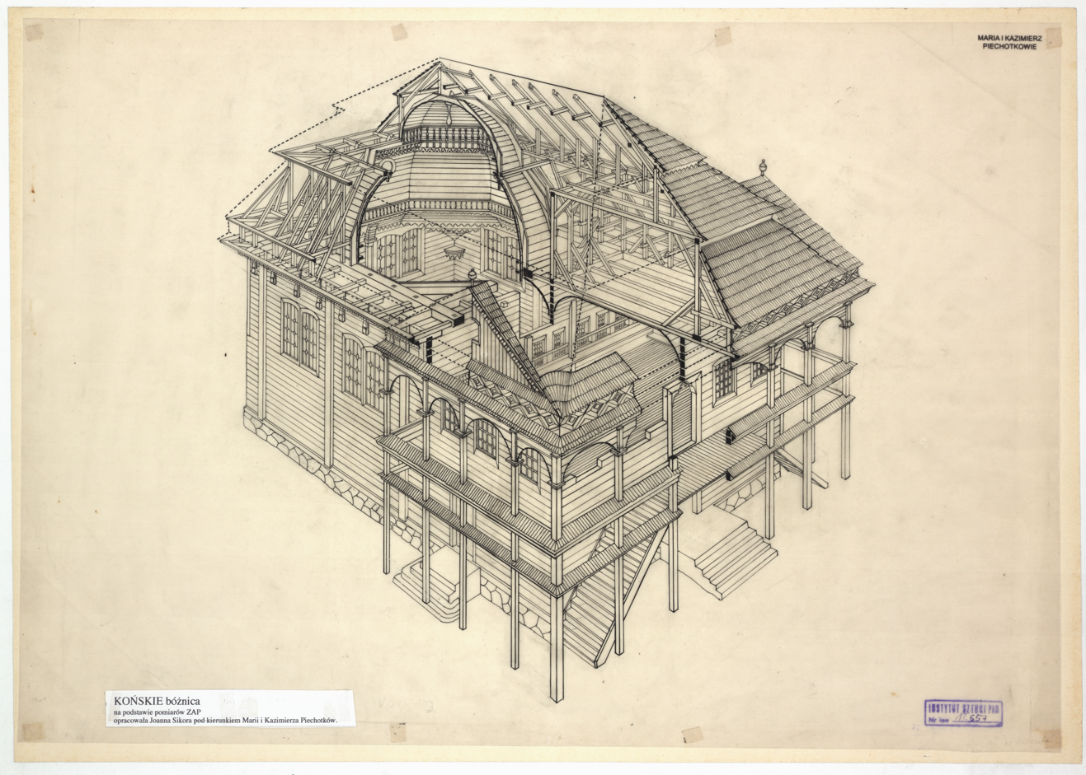
Elevations
Northern elevation
Western elevation
Before 1905
After 1905
1905 J. Sobecki, M. i K. Piechotkowie
"The Gates of Heaven"
Before 1905
Southern elevation
Eastern elevation
1931-32 J. Kahl, R. Pieńkowski, ZAP
1931-32 J. Kahl, R. Pieńkowski, ZAP
1931-32 J. Sikora, M. i K. Piechotkowie, ZAP

Slide 9
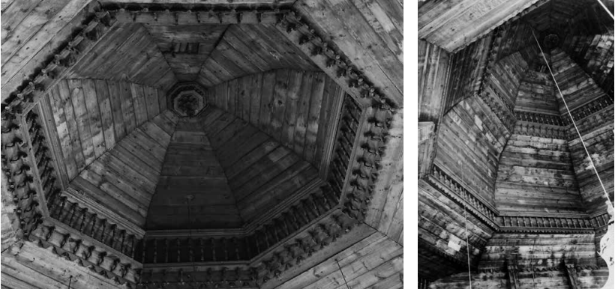
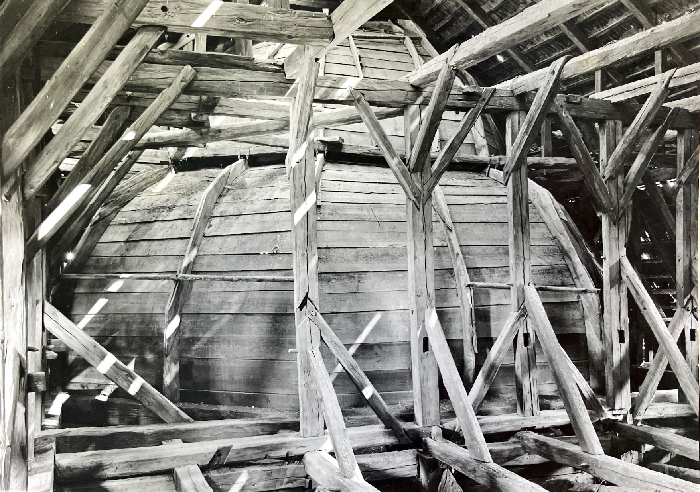
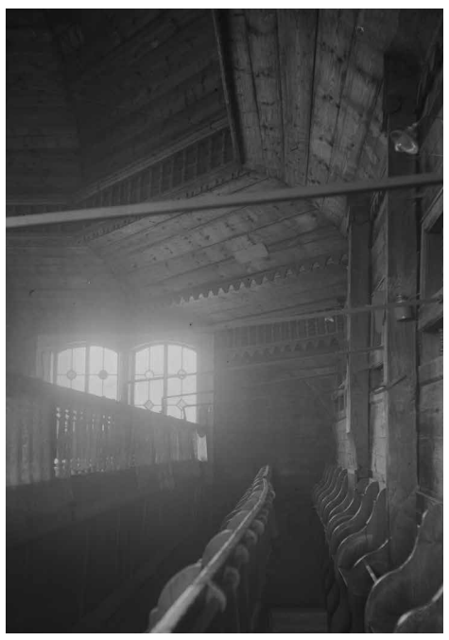
"The Gates of Heaven"
Interior
Textures
Dome
​Ezrat naszim

Slide 10
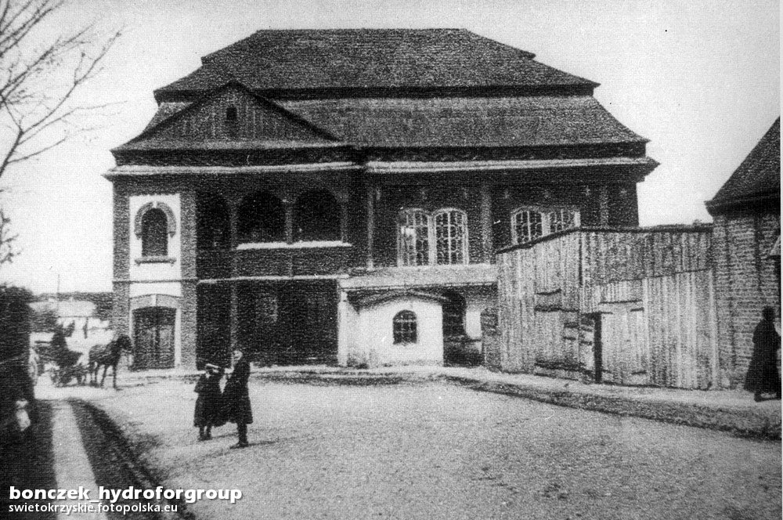
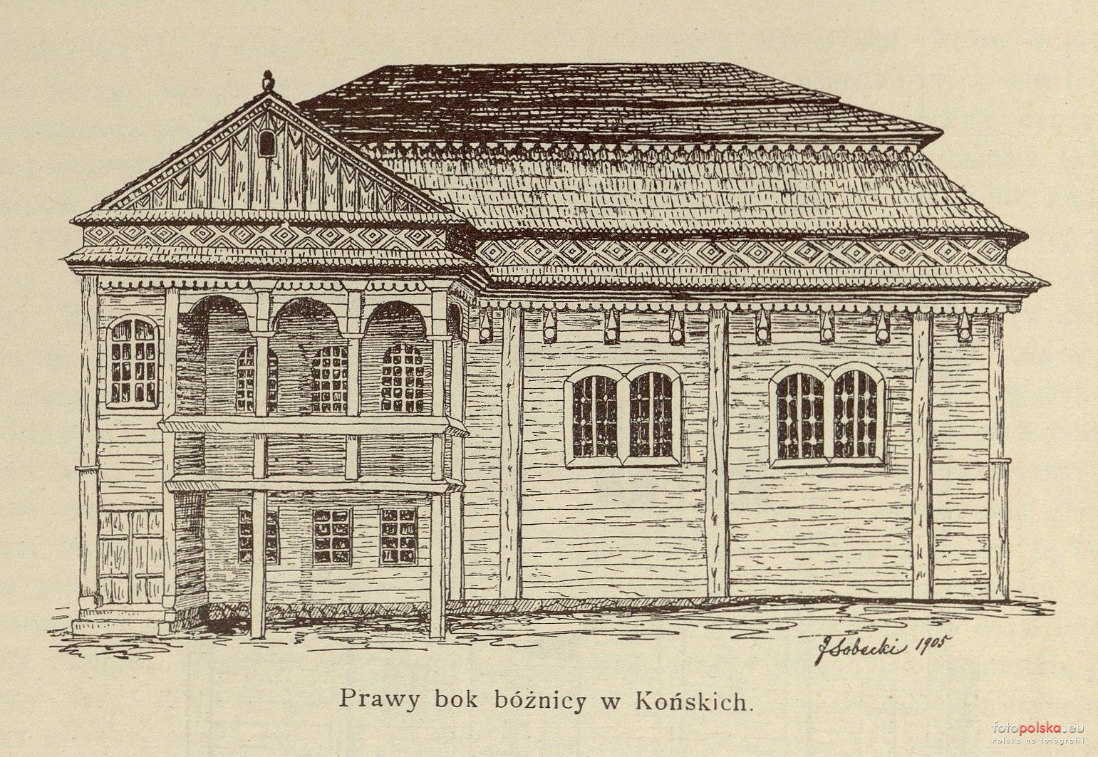
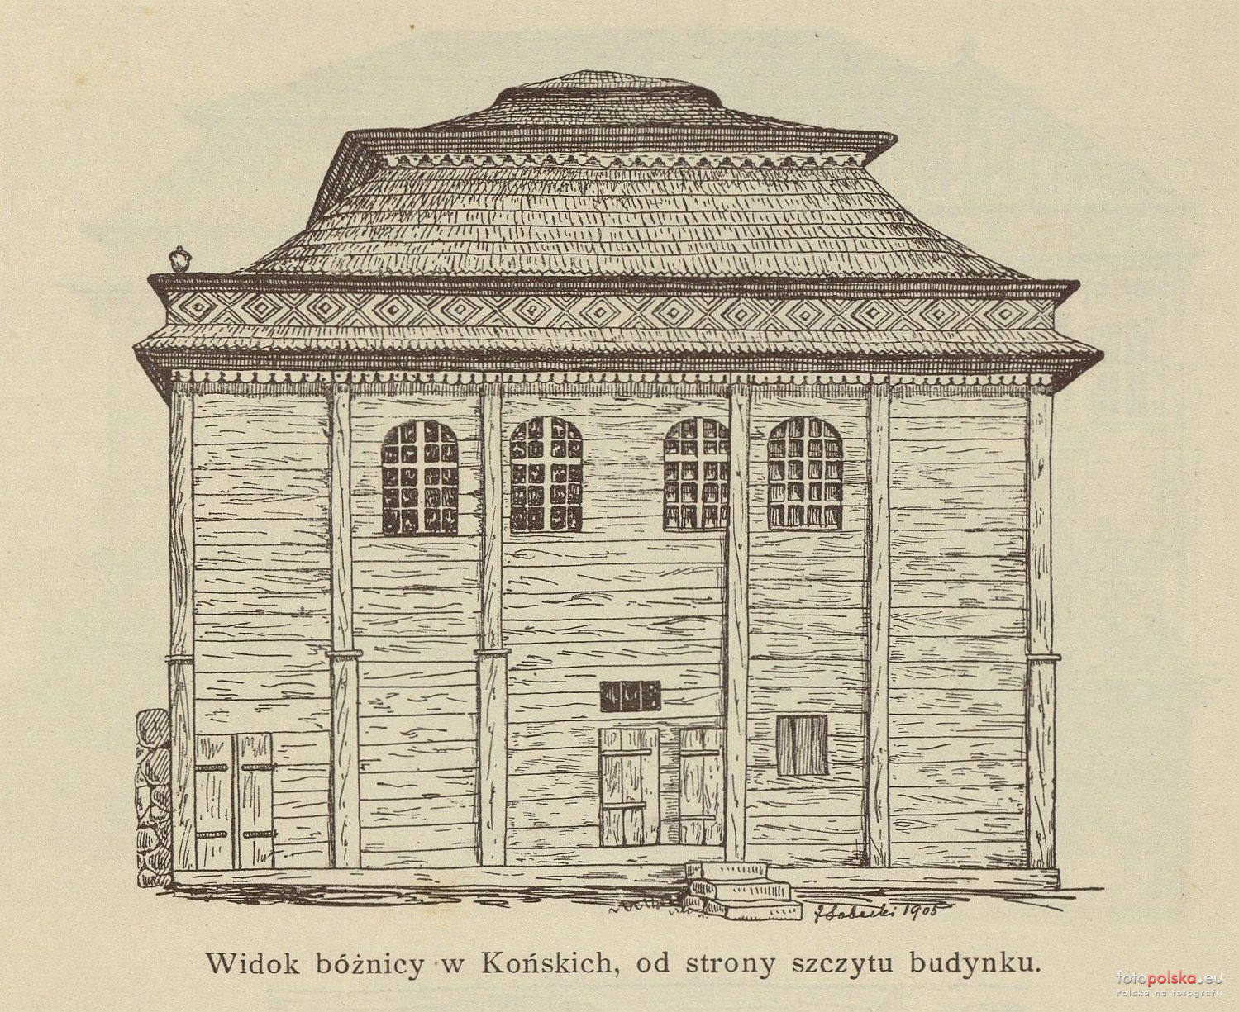
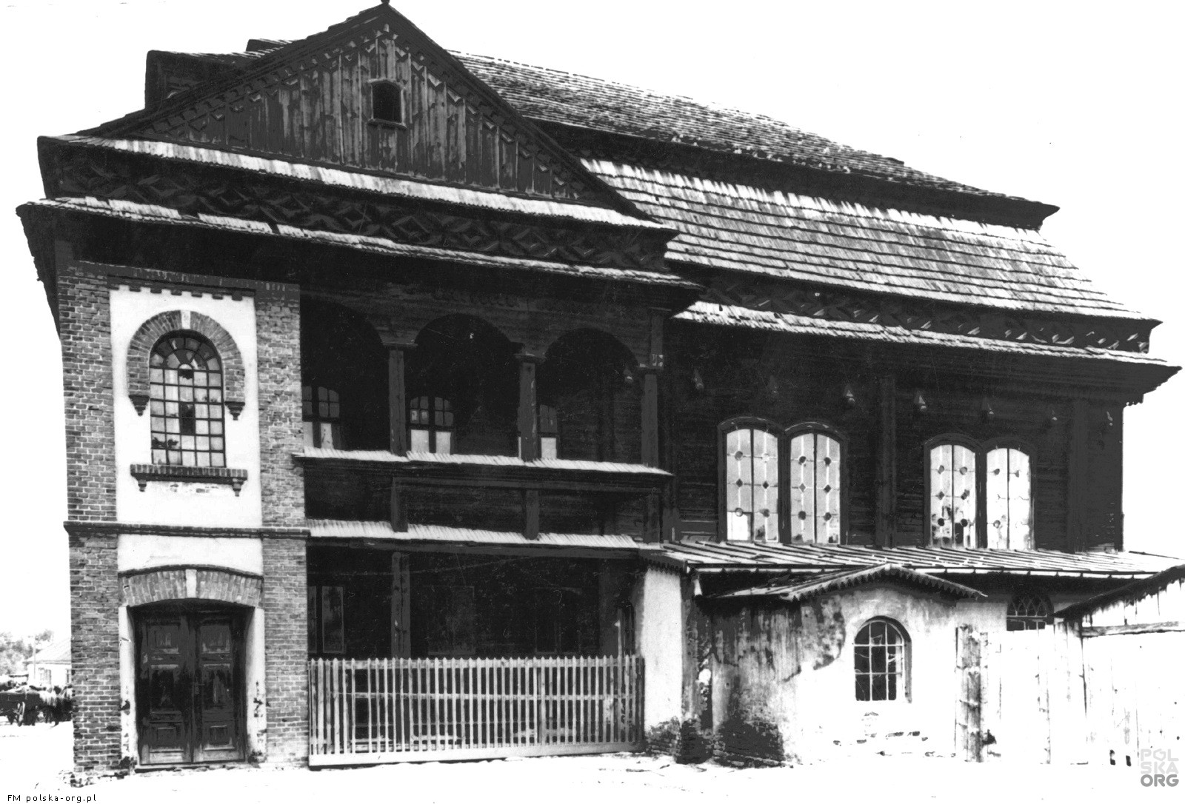
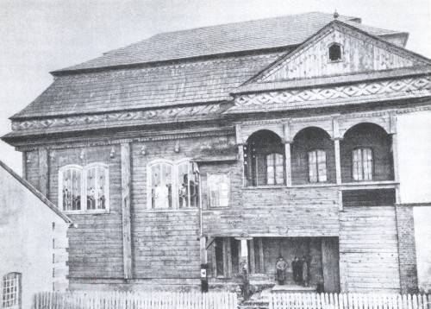
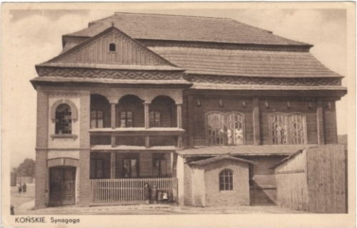
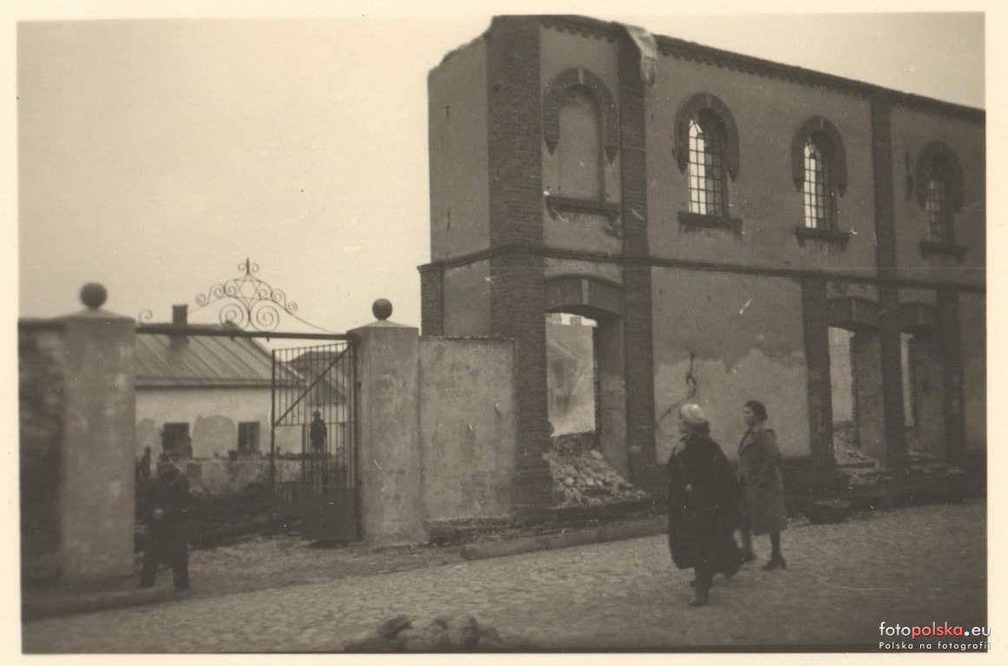
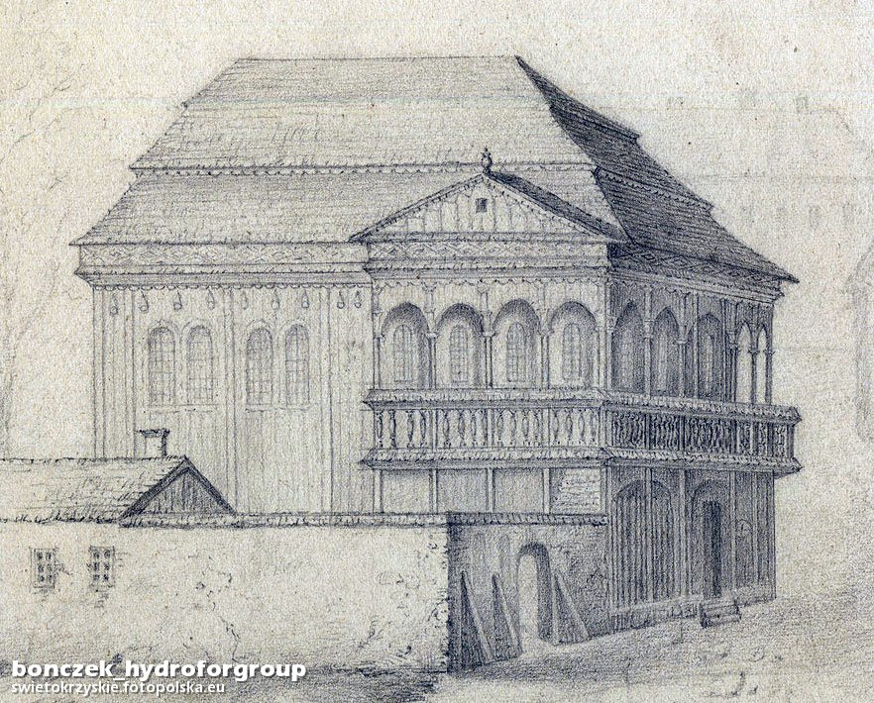
INTERNET SOURCES
Outdoor

Slide 11
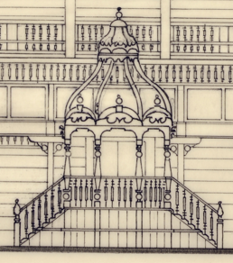
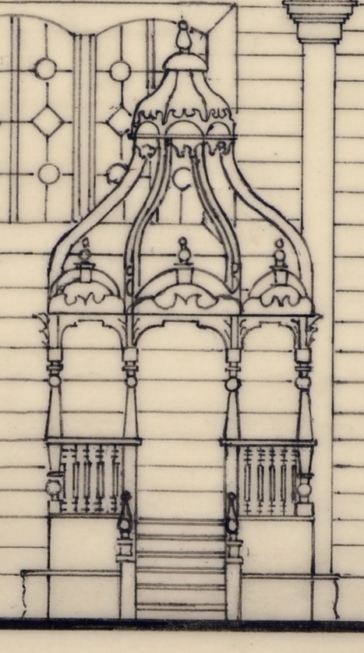
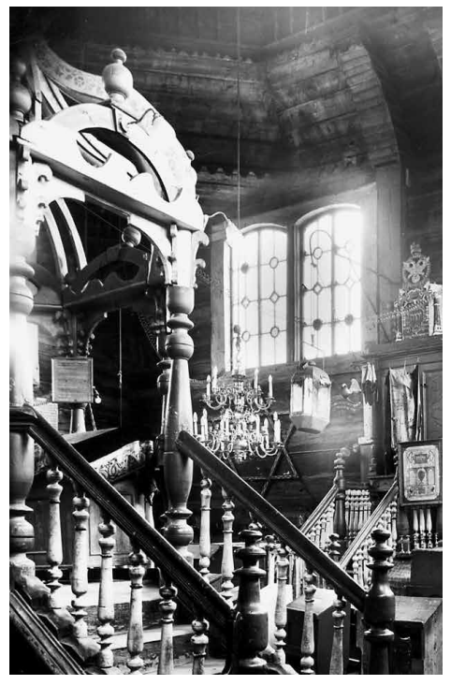
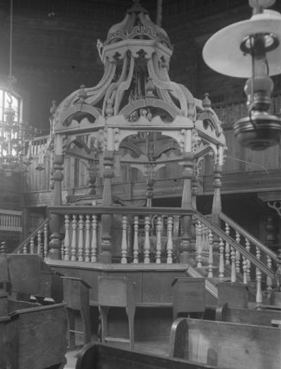
Equipment: BIMA

Slide 12
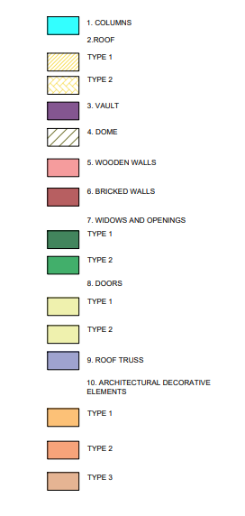
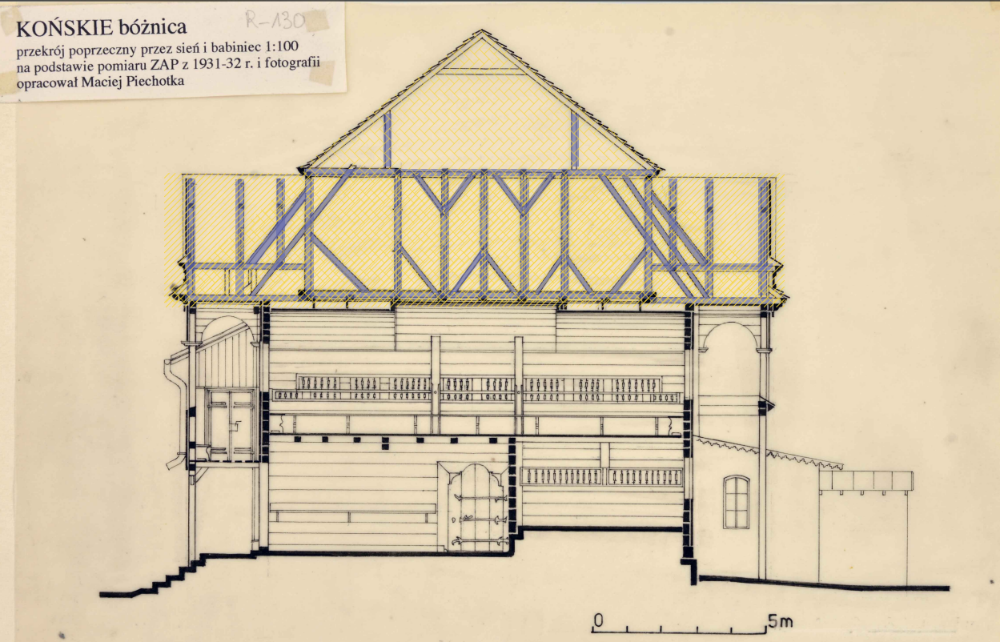

Slide 13
Internet References
https://pl.wikipedia.org/wiki/Synagoga_w_Ko%C5%84skich
https://pl.frwiki.wiki/wiki/Synagogue_de_Ko%C5%84skie_%281780-1939%29
https://pl.frwiki.wiki/wiki/Histoire_des_Juifs_%C3%A0_Ko%C5%84skie
https://sztetl.org.pl/pl/miejscowosci/k/1041-konskie/112-synagogi-domy-modlitwy-mykwy/85823-synagoga-w-konskich
https://polska-org.pl/10176613,foto.html
https://fotopolska.eu/Konskie/b4610,Synagoga.html
https://konskie.org.pl/2020/09/27/synagoga-konecka-wedrowka-przez-wieki/
http://swietokrzyskisztetl.pl

